Slide 1
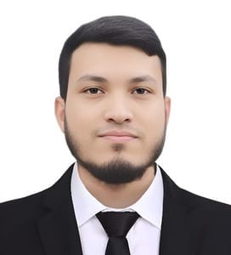
hello
I’m
Tuhin Ahmed

Slide 2





CONTraCT INFORMATION
tuhinahmod@gmail.com
Male
10-08-1996
Transport Office SUST.
01643308333

Slide 3
OBJECTIVE
I am seeking employment with a company where I can grow professionally and personally.I seek challenging opportunities where I can fully use
my skills for the success of the organization.I want to succeed in a stimulating and challenging environment that will provide me with advancement opportunities.I want to excel in this field with hard work, perseverance and dedication.I want a highly rewarding career where I can use my skills and knowledge for organizational and personal growth.I am seeking a company where I can use my experience and education to help the company meet and surpass its goals.I want to succeed in an environment of growth and excellence to meet personal and organizational goals.I am seeking a competitive and challenging environment where I can serve your organization and establish a career for myself.

Slide 4


SKILLS
Computer
Word, Exel, Powerpoint.
Electrician
Installing and maintaining electrical systems, equipment and devices. Using and maintaining hand and power tools, such as screwdrivers, pliers and drills. Repairing wiring systems. Installing electrical conduits, cables, tubing.

Slide 5





Hobbies
Travelling, Playing music, Reading Book, Playing team sports, First Food, Frelancer.

Slide 6
EDUCATION
SSC 2017
Full name of School : Sylhet Govt Technical School & Collage
Exp: GPA, 3.82
HSC 2019
Full name of Collage: Sylhet Govt Technical School & Collage
Exp: GPA, 3.56
Diploma 2020 - 2021
Full name of Collage: Sylhet Govt Technical School & Collage
Exp: 1st-2nd- year

Slide 7
WORK EXPERIENCE
City Model School, Office Assistant 2017
2 years experience of the Office assistant job.
Transport Office, SUST,
2023 - RUNNING
Computer Operator 2 year job experience.

Slide 8
REFERENCES
Amran Ahmed Chowdhury.
Executive Engineer
Transport Office, SUST.
Mohammed Abul Bashar
Assistant Register
Transport Office, SUST.

Slide 9
Thank You

